Slide 1

ACE Demo Building Dynamic Grafana Dashboards
Praveen Kumar Krishnamoorthy
Date -

Slide 2
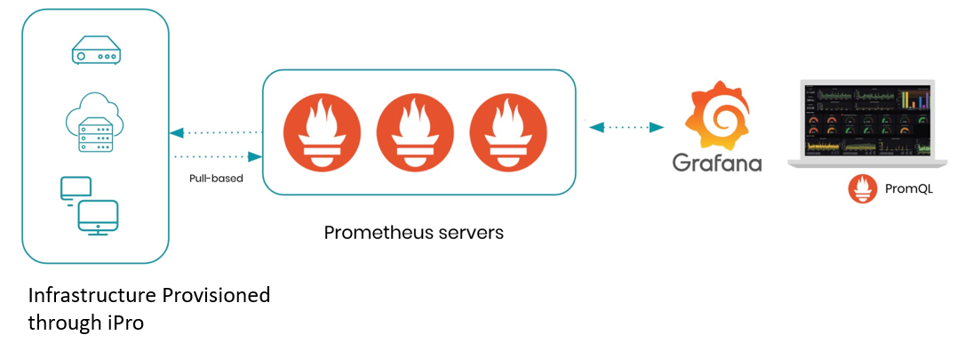

Assignment Abstract
Creating dynamic Grafana Dashboards using JSON file.
Monitoring all the infrastructure provisioned through iPro.
Import JSON File into Grafana

Slide 3
ACE Goals & Timelines - Target Vs Actual
Goals | Target | Actual
Exploring Monitoring and Various types of monitoring. Learning about Infrastructure Monitoring. Exploring Prometheus monitoring Finalized Title - Building Dynamic Grafana Dashboards using JSON Exploring what is the JSON specification and how to specify various matrices Implementation. Demo on implementation of JSON with limited metrics | Started working on 3rd Sep 2021 Started working on 9rd Sep 2021 Started working on 14th Sep 2021 Started working on 19th Oct 2021. Started Working on 20th Oct 2021 Review on 7th Mar 2022 Final content presentation on 24th Mar 2022 | Presented on 8th Sep 2021 Presented on 13th Sep 2021 Presented on 17th Sep 2021 ACE Program should complete within a span of 3 months First cut presentation on 26th Oct 2021 Final presentation on --

Slide 4
Mentor-Mentee – Interactions
Mentor | Interaction with Mentor | Discussions
Sarma Kasibhatla | Initially we started with weekly meetings. Every week we had some Task to do and also we are presenting POC’s on the task. After I Deployed into Project We started monthly meetings. | We had a discussion on what is monitoring and various types of monitoring in DevOps. Discussion on how Prometheus works and scrapes data from the nodes. Discussion about Pull and push based monitoring. Discussion about how Grafana works and integration with Prometheus. Discussion on creating JSON file for custom Grafana Dashboard

Slide 5

Knowledge Gained from ACE
I understood various types of monitoring in DevOps
and various tools used for monitoring
Infrastructure Monitoring
Application Monitoring
Network Monitoring
I learnt about Prometheus monitoring tools and installation on Linux.
I have gained knowledge on Grafana and how to integrate with Prometheus.
I learnt how to create custom Grafana dashboard using JSON.

Slide 6
Business Impact
This feature will be integrate with RAPID Platform.
This Feature is to monitor all the instances provisioned through iPro.
Once the infrastructure is provisioned through iPro the Prometheus monitoring agent would be setup automatically on the target instances.
There will not be any manual intervention to install Prometheus agent.
We will pass the value to JSON file based on infrastructure provisioned through iPro and import the JSON file into Grafana then its automatically displays the dashboard with metrics.
Metrics that can be monitored:
CPU Utilization
Memory Usage
Disk Usage
System Uptime
System Status etc..
This will help us create monitoring dashboards using Grafana automatically for a given set of resources.

Slide 7
What helped my learning during ACE?
I have prepared Prometheus from Percipio, Prometheus official site and YouTube channel's.
Here are some references which I used to learn .
Link : https://prometheus.io/docs/introduction/overview/
Link : https://www.youtube.com/watch?v=h4Sl21AKiDg
I have prepared Grafana from Grafana official site and YouTube channel’s.
Here are some references which I used to learn.
Link : https://grafana.com/docs/grafana/latest/installation/debian/
Link : https://grafana.com/grafana/dashboards/13978?pg=dashboards&plcmt=featured- dashboard-2

Slide 8
ACE– Feedback on the Program
ACE program helped me to understand more about monitoring in DevOps.
Monitoring is mandatory for all the infrastructure and services deployed either on Cloud platform or On-Premises environment.
Managing the lifecycle monitoring is important, so this program helped me to learn more monitoring tools that could be utilized in an project that I take up in future.
This program helped me to learn building dynamic Grafana dashboards with JSON file.

Slide 9
Demo of the Assignment
Praveen Kumar Krishnamoorthy
Date –

Slide 10




Communication Flow Diagram
iPro
Grafana Dashboard with Metrics
Pull Metrics
JSON file need to import in Grafana
Node Exporter Agent
Grafana
Prometheus
Infrastructure Provisioned through iPro

Slide 11
Grafana Dashboards
There are two ways to create Grafana Dashboards
Writing JSON file
Using PromQl Queries

Slide 12
Prerequisite
Prometheus should be installed.
Prometheus Agent (Node Exporter) should be installed on the Servers which we want to monitor.
Grafana should be installed.
Custom JSON file which we will upload in Grafana.

Slide 13
Sample JSON for Total RAM Available
{
"datasource": "Prometheus",
"fieldConfig": {
"defaults": {
"color": {
"mode": "thresholds"
},
"mappings": [],
"thresholds": {
"mode": "absolute",
"steps": [
{
"color": "#dbe3e3",
"value": null
}
]
},
"unit": "bytes"
},
"overrides": []
},
"gridPos": {
"h": 5,
"w": 5,
"x": 19,
"y": 0
},
"id": 20,
"options": {
"colorMode": "value",
"graphMode": "area",
"justifyMode": "auto",
"orientation": "auto",
"reduceOptions": {
"calcs": [
"lastNotNull"
],
"fields": "",
"values": false
},
"text": {},
"textMode": "auto"
},
"pluginVersion": "8.1.7",
"targets": [
{
"exemplar": true,
"expr": "node_memory_MemTotal_bytes{instance=\"$node\",job=\"$job\"}",
"interval": "",
"legendFormat": "",
"refId": "A"
}
],
"title": "RAM Total",
"type": "stat"
}

Slide 14
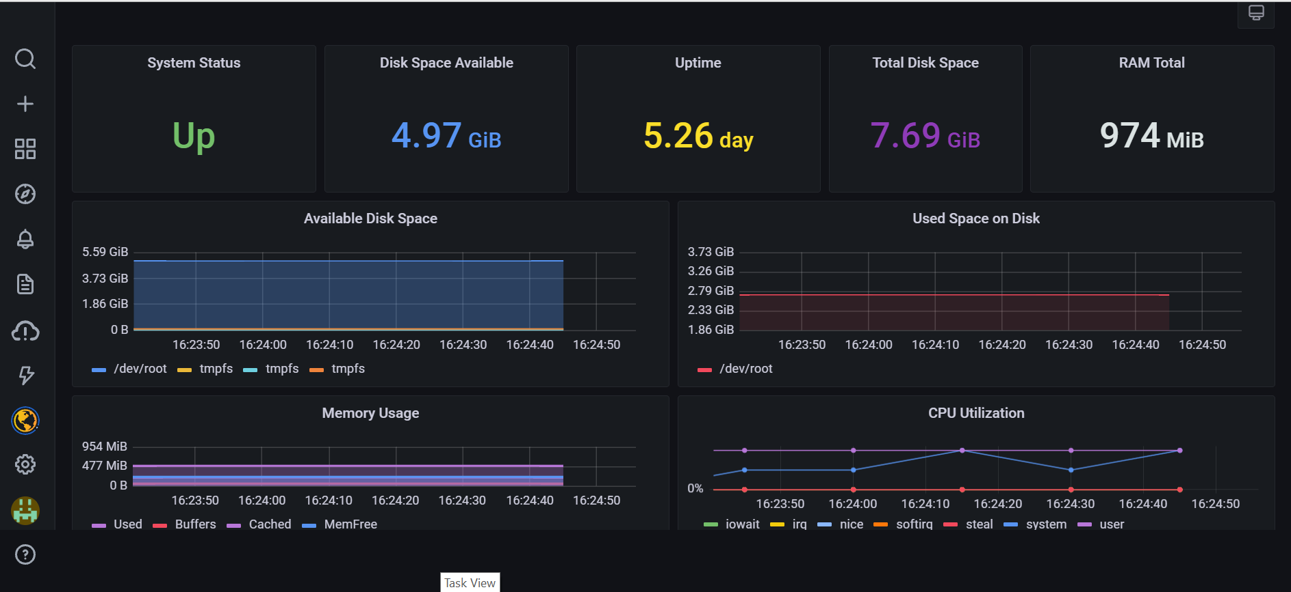
Sample Grafana dashboard for Node Exporter

Slide 15
Questions from Panel

